Slide 1
Heap sort
Dr. Yasir | Programming Domain

Slide 2
What is heap sort?
Heapsort is a popular and efficient sorting algorithm.
The concept of heap sort is to eliminate the elements one by one from the heap part of the list, and then insert them into the sorted part of the list
Notes:
Insert a map of your country.

Slide 3
Working of Heap sort Algorithm
There are two phases involved in the sorting of elements.
The first step includes the creation of a heap by adjusting the elements of the array.
After the creation of heap, now remove the root element of the heap repeatedly by shifting it to the end of the array, and then store the heap structure with the remaining element
Notes:
Insert a map of your country.

Slide 4

Example
Create max heap
Notes:
Insert a map of your country.

Slide 5
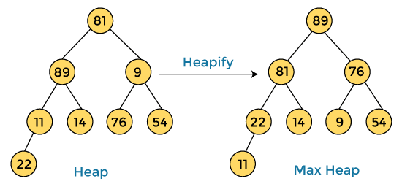
example
let's take an unsorted array and try to sort it using heap sort.
First, we have to construct a heap from the given array and convert it into max heap.
Notes:
Insert a map of your country.

Slide 6

After converting the given heap into max heap, the array elements are –
Notes:
Insert a map of your country.

Slide 7
Next, we have to delete the root element (89) from the max heap.
To delete this node, we have to swap it with the last node, i.e. (11).
After deleting the root element, we again have to heapify it to convert it into max heap.
Notes:
Insert a map of your country.

Slide 8
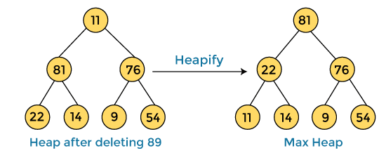

After swapping the array element 89 with 11, and converting the heap into max-heap, the elements of array are –
Notes:
Insert a map of your country.

Slide 9
In the next step, again, we have to delete the root element (81) from the max heap.
To delete this node, we have to swap it with the last node, i.e. (54).
After deleting the root element, we again have to heapify it to convert it into max heap.
Notes:
Insert a map of your country.

Slide 10
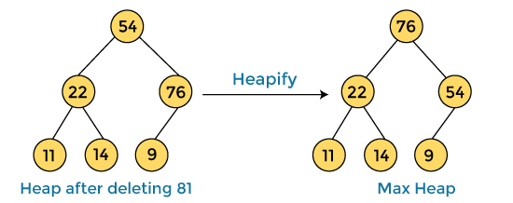

After swapping the array element 81 with 54 and converting the heap into max-heap, the elements of array are -
Notes:
Insert a map of your country.

Slide 11
In the next step, we have to delete the root element (76) from the max heap again.
To delete this node, we have to swap it with the last node, i.e. (9).
After deleting the root element, we again have to heapify it to convert it into max heap.
Notes:
Insert a map of your country.

Slide 12
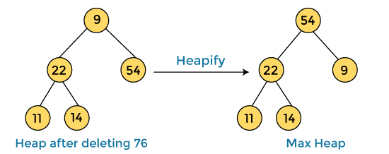

After swapping the array element 76 with 9 and converting the heap into max-heap, the elements of array are –
Notes:
Insert a map of your country.

Slide 13
In the next step, again we have to delete the root element (54) from the max heap.
To delete this node, we have to swap it with the last node, i.e. (14).
After deleting the root element, we again have to heapify it to convert it into max heap.
Notes:
Insert a map of your country.

Slide 14
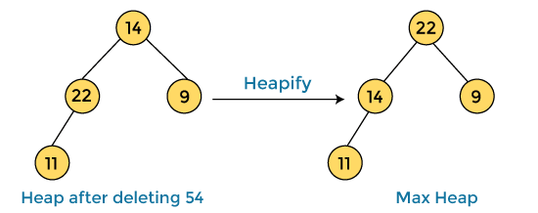

After swapping the array element 54 with 14 and converting the heap into max-heap, the elements of array are –
Notes:
Insert a map of your country.

Slide 15
In the next step, again we have to delete the root element (22) from the max heap.
To delete this node, we have to swap it with the last node, i.e. (11).
After deleting the root element, we again have to heapify it to convert it into max heap.
Notes:
Insert a map of your country.

Slide 16
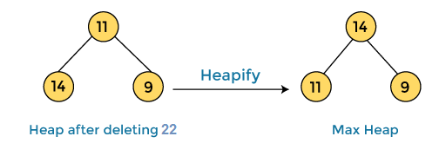

After swapping the array element 22 with 11 and converting the heap into max-heap, the elements of array are
Notes:
Insert a map of your country.

Slide 17
In the next step, again we have to delete the root element (14) from the max heap.
To delete this node, we have to swap it with the last node, i.e. (9).
After deleting the root element, we again have to heapify it to convert it into max heap.
Notes:
Insert a map of your country.

Slide 18
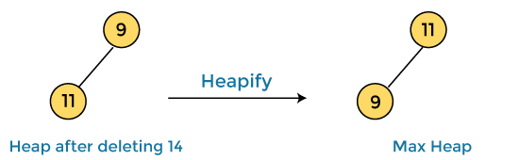

After swapping the array element 14 with 9 and converting the heap into max-heap, the elements of array are –
Notes:
Insert a map of your country.

Slide 19
In the next step, again we have to delete the root element (11) from the max heap.
To delete this node, we have to swap it with the last node, i.e. (9).
After deleting the root element, we again have to heapify it to convert it into max heap.
Notes:
Insert a map of your country.

Slide 20
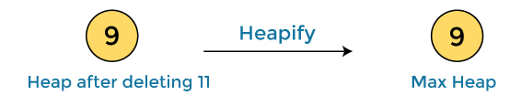

After swapping the array element 11 with 9, the elements of array are
Notes:
Insert a map of your country.

Slide 21


Now, heap has only one element left. After deleting it, heap will be empty.
After completion of sorting, the array elements are
Now, the array is completely sorted.
Notes:
Insert a map of your country.

